Slide 1
Introduction to Data Structures
Module 1

Slide 2
Data
Data can be numeric or character
When we process this data, it becomes information.
Eg- MH32V2126,
A string, sequence of character type data
But when it represents the car registration number then it is processed data
I.e. information.

Slide 3
DATA STRUCTURES
Data may be organized in many different ways. The logical or mathematical model of a particular organization of data is called a Data Structure. Or
In other words, a Data Structure is a way of organizing all the data items that considers not only the elements stored but also the relationship between them.

Slide 4
Data Structure
Data Structure is a way to organize the data in some way so we can perform operations on these data in effective ways.
Eg-List, Stack, Queue, Tree

Slide 5
Selection/choice of data structures
The choice of Data Structure model depends on two considerations-
It must be rich enough in structure to mirror the actual relationships of the data in the real world.
The structure should be simple enough that one can effectively process the data when necessary,
i.e. the type of operation to be performed.

Slide 6
Data Structure
Data Structures affects the design of both the structural and functional aspects of a program.

Slide 7
Data Structure
ALGORITHM+DATA STRUCTURE=PROGRAM
Algorithm is a step by step procedure to solve a particular problem.
To develop a program we should select an appropriate data structure for that algorithm.
Thus , algorithm and its associated data structure form a program.

Slide 8
CLASSIFICATION OF DATA STRUCTURES
Data Structure
Primitive Data Structure
Integer
Float
Non-Primitive Data Structure
Linear
Character
Double
Non-Linear
Array
Lists
Stack
Queues
Trees
Graphs

Slide 9
PRIMITIVE DATA STRUCTURES
These are basic data structures and are directly operated upon by the machine level instructions.
These in general have different representations on different computers.
Integers, floating point numbers, character constants, double etc fall in this category.

Slide 10
NON-PRIMITIVE DATA STRUCTURES
These are more sophisticated data structures.
These are derived from the basic data types.
The non-primitive data structures emphasize on structuring of a
group of homogenous(same type) or
heterogenous (different type) data items.
Eg- Arrays, lists, trees etc.

Slide 11
NON-PRIMITIVE DATA STRUCTURES
Classified as
Linear data structures
Non- Linear data structures

Slide 12
Linear Data Structures
A data structure is said to be linear
if its elements form a sequence or a linear list.
Here elements are arranged in one dimension or linear fashion.
All one-one relation can be handled through linear data structures.
Eg- Lists, stacks and queues

Slide 13
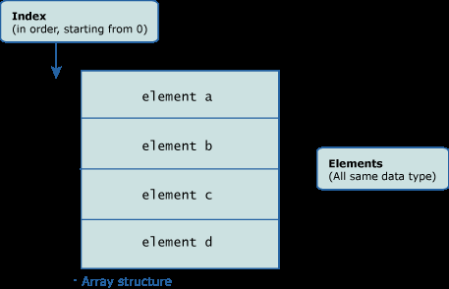
Arrays
An array can be defined as a collection of homogenous data type.
An array can store either all integers, all floating point numbers, all characters or any other complex data type.
Declaration of an integer array is as follows-
int a[10];

Slide 14

Lists
Linked lists are special lists of some data elements linked to one another.
The logical ordering is represented by
having each element pointing to the next element.
Each element is called a node, which has two parts, INFO part which stores the information and pointer which points to the next element.

Slide 15
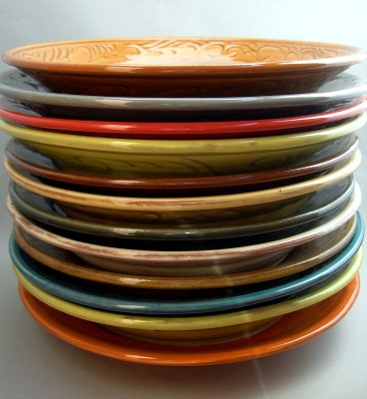
Stacks

Slide 16
Stacks
It could be thought of just like a stack of plates placed on table in a party,
a guest always takes off a fresh plate from the top, and
the new plates are placed on the top of the stack .

Slide 17
Stacks
The plate which is at the top is the first one to be removed,
The plate which has been placed at the bottommost position remains in the stack for the longest period of time.
So, it can be simply seen to follow LIFO(Last In First Out)/FILO(First In Last Out) order.

Slide 18
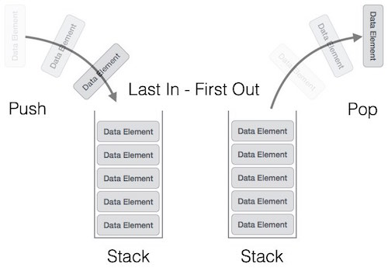
Stacks
Stack is a linear data structure which follows a particular order in which the operations are performed.
The order may be LIFO(Last In First Out) or FILO(First In Last Out).

Slide 19
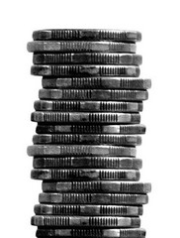

Stacks
A Stack is an ordered collection of elements , but it has a special feature that deletion and insertion of elements can be done only from one end, called the top of the stack(TOP).

Slide 20
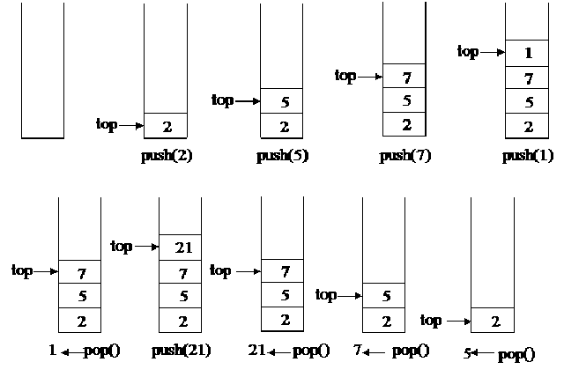
Operation on Stacks
Push operation-The insertion of an element into stack
Pop operation - Deletion of an element from the stack
In stack we always keep track of the last element present in the list with a pointer called top.

Slide 21
Applications of stack:
Expression evaluation and syntax parsing
Balancing of symbols, paranthesis
Infix to Postfix /Prefix conversion
Reverse a String using Stack
Redo-undo features at many places like editors, photoshop.
Forward and backward feature in web browsers
Used in many algorithms like Tower of Hanoi, tree traversals, stock span problem, histogram problem.

Slide 22
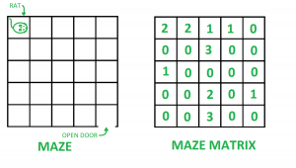
Applications of stack:
Backtracking
Backtracking is an algorithmic-technique for
solving problems recursively by trying to build a solution incrementally, one piece at a time,
removing those solutions that fail to satisfy the constraints of the problem at any point of time
Other applications can be Backtracking, Knight tour problem, rat in a maze, N queen problem and sudoku solver

Slide 23
Backtracking-Finding the correct path in a maze.
There are a series of points, from the starting point to the destination.
We start from one point. To reach the final destination, there are several paths.
Suppose we choose a random path. After following a certain path, we realise that the path we have chosen is wrong. So we need to find a way by which we can return to the beginning of that path.

Slide 24
Backtracking-Finding the correct path in a maze.
This can be done with the use of stacks. With the help of stacks, we remember the point where we have reached.
This is done by pushing that point into the stack.
In case we end up on the wrong path, we can pop the top point from the stack and thus return to the last point and continue our quest to find the right path.

Slide 25
Applications of stack:
Depth-first search
The prototypical example of a backtracking algorithm is depth-first search, which finds all vertices of a graph that can be reached from a specified starting vertex.
In Graph Algorithms like Topological Sorting and Strongly Connected Components

Slide 26
Applications of stack:
Compile time memory management
Almost all calling conventions‍

Slide 27
Function calls using stack
Compile time memory management
A number of programming languages are stack-oriented,
meaning they define most basic operations as taking their arguments from the stack, and placing any return values back on the stack.
Eg- adding two numbers, printing a character

Slide 28
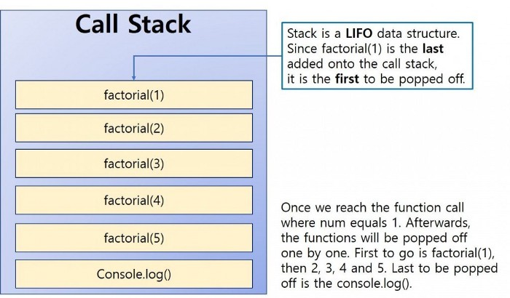
Function calls using stack
Stacks are an important way of supporting nested or recursive function calls.

Slide 29
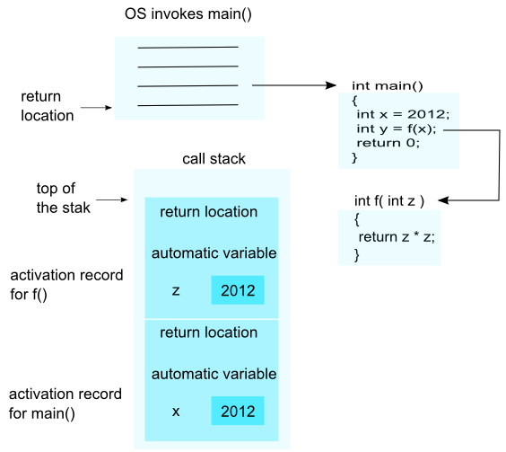
Function calls using stack
The ways in which subroutines receive their parameters and return results‍—‌use a special stack (the "call stack")

Slide 30
Function calls using stack
Call stack holds information
about procedure/function calling and nesting
in order to switch to the context of the called function and
restore to the caller function when the calling finishes.

Slide 31
Applications of stack:
Efficient algorithms
The nearest-neighbor chain algorithm,
Graham scan, an algorithm for the convex hull of a two-dimensional system of points. A convex hull of a subset of the input is maintained in a stack, which is used to find and remove concavities in the boundary when a new point is added to the hull
Security
Some computing environments use stacks in ways that may make them vulnerable to security breaches and attacks.
Programmers working in such environments must take special care to avoid the pitfalls of these implementations.

Slide 32
Data Structures | Stack | Question 2
Which one of the following is an application of Stack Data Structure? (A) Managing function calls (B) The stock span problem (C) Arithmetic expression evaluation (D) All of the above

Slide 33
Data Structures | Stack | Question 2
Which one of the following is an application of Stack Data Structure? (A) Managing function calls (B) The stock span problem (C) Arithmetic expression evaluation (D) All of the above Answer: (D)

Slide 34
Queues

Slide 35
Real life Examples of Queue
The people standing in a railway reservation row are an example of queue. Each new person comes and stands at the end of the row (rear end of queue) and persons getting their reservations confirmed , get out of the row from the front end.

Slide 36

Real life Examples of Queue
Our software queues have counterparts in real world queues.
We wait in queues
to buy pizza,
to enter movie theaters,
to drive on a turnpike, and
to ride on a roller coaster.

Slide 37
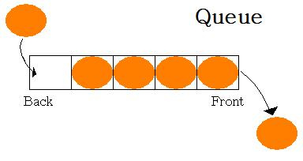
Queues
A Queue is a linear structure which follows a particular order in which the operations are performed.
The order is FIFO, Queues are first in first out type of data structures( FIFO).
In a queue new elements are added to the queue from one end called Rear end and the elements are always removed from the other end called the Front end.

Slide 38
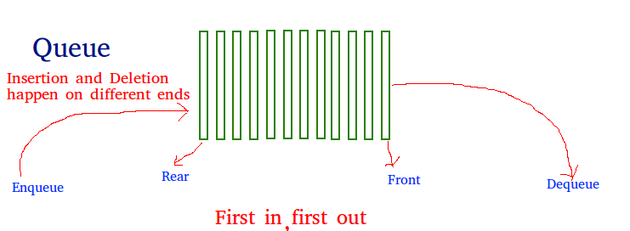
Operations on Queue:
Enqueue:
Adds an item to the queue
Enter or Insert an item from Rear end
Dequeue:
Removes an item from the queue.
Service or Delete From the Front end

Slide 39
Applications of Queue:
Queues are widely used as waiting lists for a single shared resource like printer, disk, CPU.
Disk Scheduling

Slide 40
Applications of Queue:
CPU scheduling-
When multiple processes require CPU at the same time, various CPU scheduling algorithms are used which are implemented using Queue data structure.

Slide 41
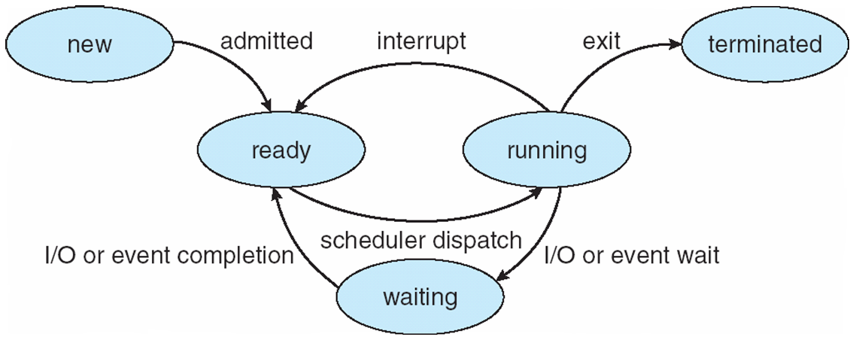
Applications of Queue:
CPU scheduling-

Slide 42
Applications of Queue:
When things don’t have to be processed immediately, but have to be processed in First In First Out order like Breadth First Search.
When data is transferred asynchronously (data not necessarily received at same rate as sent) between two processes. Examples include IO Buffers, pipes, file IO, etc.
Queue are used to maintain the play list in media players in order to add and remove the songs from the play-list.
Courtesy:https://www.javatpoint.com/data-structure-queue

Slide 43
Queue Example
Accessing printer in multiuser environment-
If a printer is in process and more than one user wants to access the printer then
it maintains the queue for user requesting access and serves in FIFO manner for giving access.

Slide 44
Difference between Stacks and Queues
The difference between stacks and queues is in removing.
In a stack, we remove the item which was most recently added;
In a queue, we remove the item which was least recently added.

Slide 45
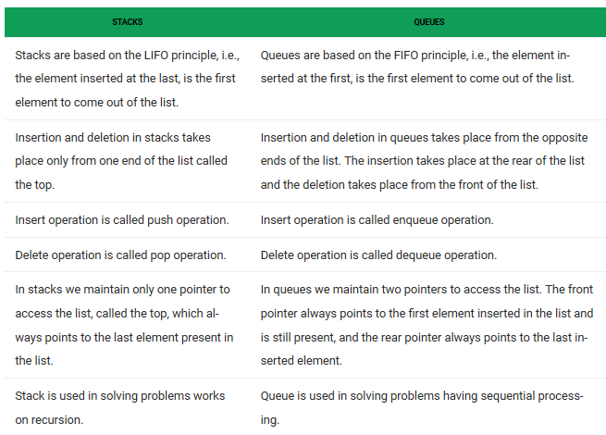
Difference between Stacks and Queues

Slide 46
Non-Linear Data Structures
A data structure is said to be non-linear if traversal of nodes is nonlinear in nature.
Data elements are not arranged sequentially or linearly are called non-linear data structures.
In a non-linear data structure, single level is not involved. Therefore, we can’t traverse all the elements in single run only.

Slide 47
Non-Linear Data Structures
A non-linear data structure has no set sequence of connecting all its elements and each element can have multiple paths to connect to other elements.

Slide 48
Non-Linear Data Structures
All one-many, many-one or many-many relations are handled through non-linear data structures.
Every data element can have a number of predecessors as well as successors.
Trees, graphs and tables are its examples.

Slide 49
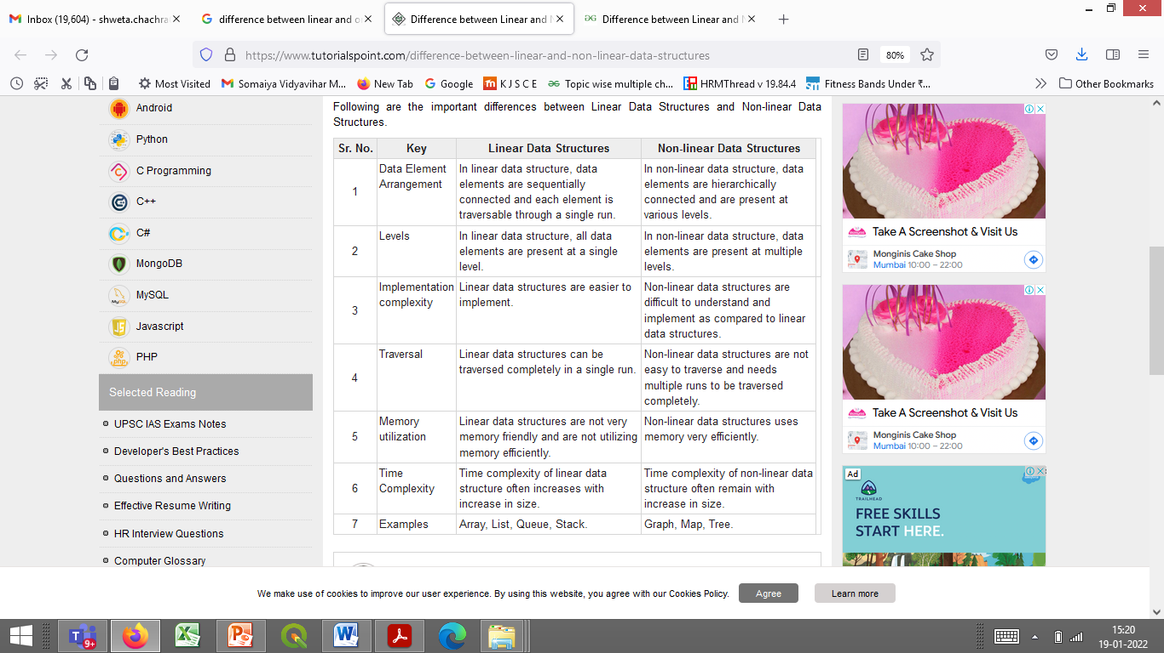
Linear Vs Non Linear Data Structures

Slide 50
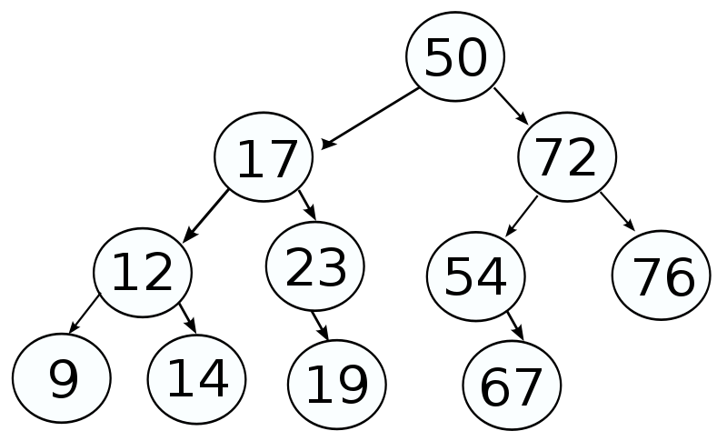
Trees
A tree is a non- linear data structure used to represent hierarchical relationship existing among several data items.

Slide 51
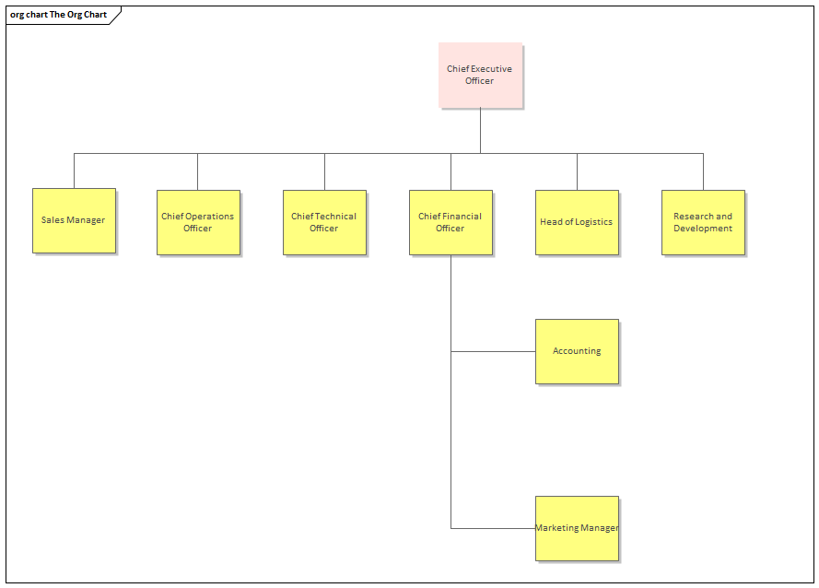
Tree
Represents Hierarchy
For eg- The organization structure of an Corporation

Slide 52
Trees
It is a finite set of one or more data items such that-
There is a special data item called the root of the tree.
Its remaining data items are partitioned into number of mutually exclusive subsets, each of which is itself a tree, and they are called subtrees.

Slide 53
Applications of Tree Data Structure
Store hierarchical data, like folder structure, organization structure, XML/HTML data.
Binary Search Tree is a tree that allows fast search, insert, delete on a sorted data. It also allows finding closest item
Heap is a tree data structure which is implemented using arrays and used to implement priority queues.

Slide 54
Applications of Tree Data Structure
B-Tree and B+ Tree : They are used to implement indexing in databases.
Syntax Tree: Used in Compilers.
Spanning Trees and shortest path trees are used in routers and bridges respectively in computer networks

Slide 55
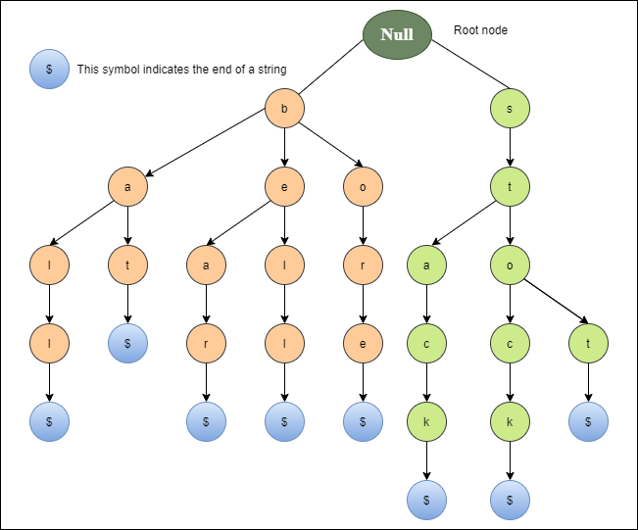
Applications of Tree Data Structure
Trie : Used to implement dictionaries with prefix lookup.

Slide 56
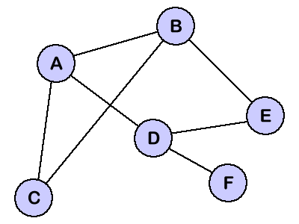
Graphs
Graph is a non-linear data structure capable of representing many kinds of physical data structures.
It has found its application in diverse fields like Geography, Chemistry and Engineering Sciences.

Slide 57
Graphs
A graph G(V,E) is a set of vertices V and a set of edges E.
An edge connects a pair of vertices and many have weight such as length, cost etc.
Vertices =point or circles
Edges=arcs or line segment.
Edge E=(V,W) where V and W are pair of vertices.

Slide 58
GRAPHS Representation :
Graph representation of a road network
A road network is a simple example of a graph,
Vertices represents cities and road connecting them are correspond to edges.

Slide 59
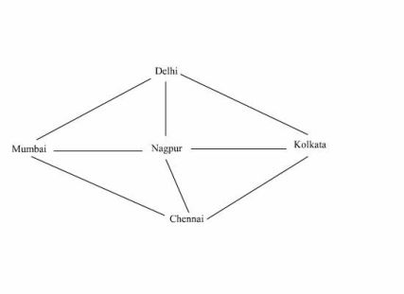
GRAPHS Representation :
V= { Delhi, Chenai, Kolkata, Mumbai, Nagpur }
E= { (Delhi, Kolkata), (Delhi, Mumbai}, (Delhi, Nagpur), (Chenai, Kolkata), (Chenai, Mumbai), (Chenai, Nagpur), (Kolkata, Nagpur), (Mumbai, Nagpur) }

Slide 60
Applications of Graph Data Structure
?

Slide 61
Applications of Graph Data Structure
Google maps
Facebook
World Wide Web
Operating System

Slide 62
Applications of Graph Data Structure
Google maps –
?

Slide 63
Applications of Graph Data Structure
In Computer science graphs are used to represent the flow of computation.
Google maps –
uses graphs for building transportation systems,
where intersection of two(or more) roads are considered to be a vertex and
the road connecting two vertices is considered to be an edge,
thus their navigation system is based on the algorithm to calculate the shortest path between two vertices.

Slide 64
Applications of Graph Data Structure
In Facebook,
?

Slide 65
Applications of Graph Data Structure
In Facebook,
users are considered to be the vertices and
if they are friends then there is an edge running between them.
Facebook’s Friend suggestion algorithm uses graph theory.
Facebook is an example of undirected graph.

Slide 66
Applications of Graph Data Structure
In World Wide Web,
web pages are considered to be the vertices.
There is an edge from a page u to other page v if there is a link of page v on page u.
This is an example of Directed graph.
It was the basic idea behind Google Page Ranking Algorithm.

Slide 67
Applications of Graph Data Structure
In Operating System,
we come across the Resource Allocation Graph where
each process and resources are considered to be vertices.

Slide 68
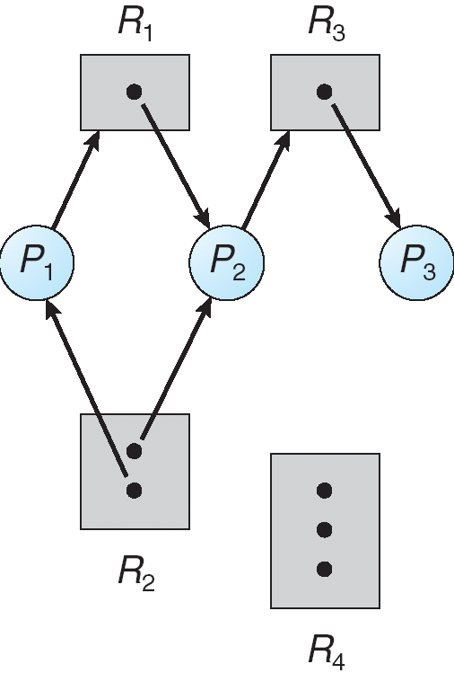
Applications of Graph Data Structure
Edges are drawn from
resources to the allocated process, or
from requesting process to the requested resource.
If this leads to any formation of a cycle then a deadlock may occur.

Slide 69
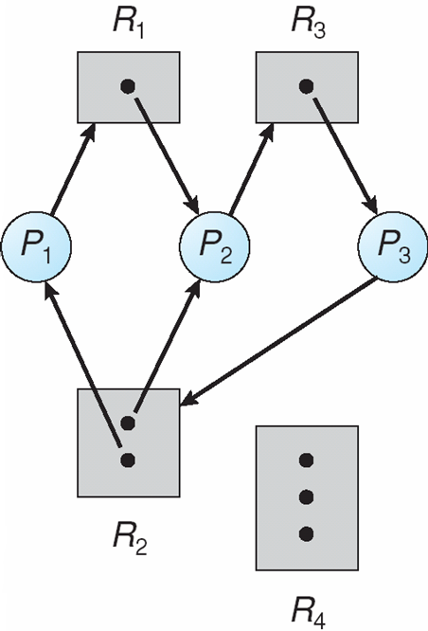
Resource Allocation Graph With A Deadlock
Suppose P3 requests for R2,
Since no resource instance is free, a request edge P3->R2 is added
So, Now Two cycles exist –
P1->R1->P2->R3->P3->R2->P1
P2->R3->P3->R2->P2
P1,P2,P3 are deadlocked

Slide 70
GATE CS 2004
The best data structure to check whether an arithmetic expression has balanced parentheses is a (GATE CS 2004) a) queue b) stack c) tree d) list

Slide 71
GATE CS 2004
The best data structure to check whether an arithmetic expression has balanced parentheses is a (GATE CS 2004) a) queue b) stack c) tree d) list
Answer(b)

